Slide 1
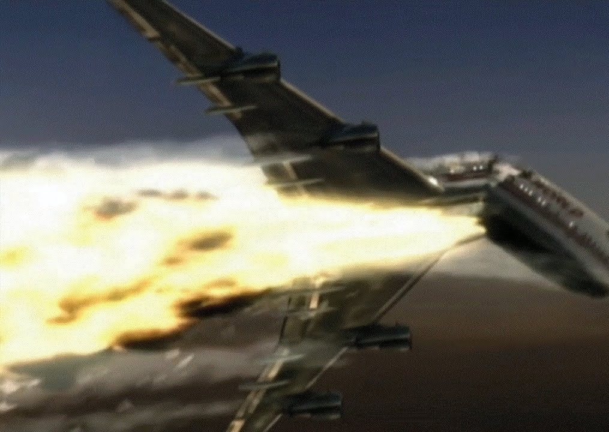
TWA Flight 800 Boeing 747
MECH 428 Term Project Presentation
Introduction to Aerospace
Sinan Noyan
Batuhan Yalçın
Mehmet Can İlker
Malik Buğra Tavukçuoğlu
Emre Güzelaydın
Beratcan Altuntaş

Slide 2
Order of Contents
Introduction of TWA Flight 800
Background Information on the Aircraft
Accident Characteristics – 5 Pillars of Analysis
Root Cause – Direct Cause Connection
General System Analysis / Vulnerabilities
Statistical Reliability
Related Accidents
Corrective Measures
References

Slide 3
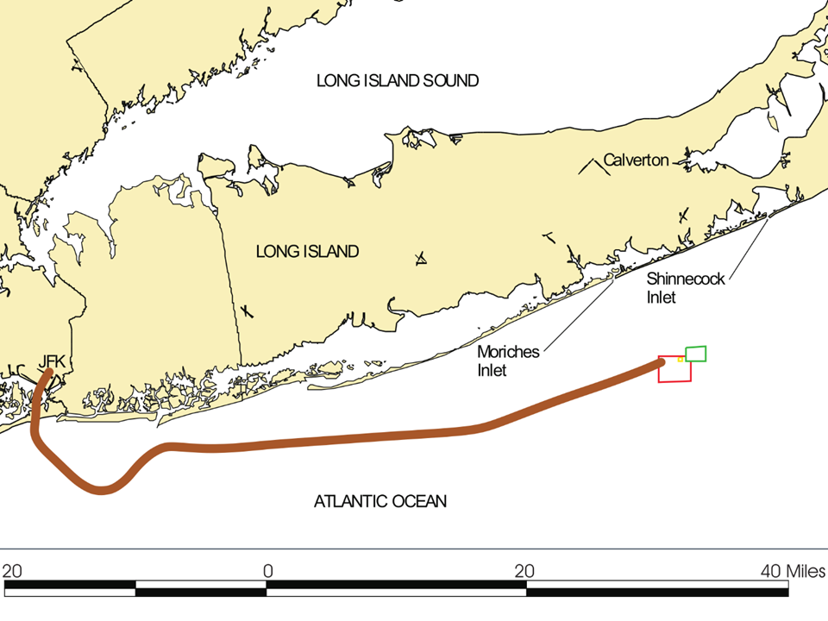
Introduction
TWA Flight 800
JFK – CDG
20:14 – 20:31
Central Wing Fuel Tank Explosion
In-Flight Break up

Slide 4
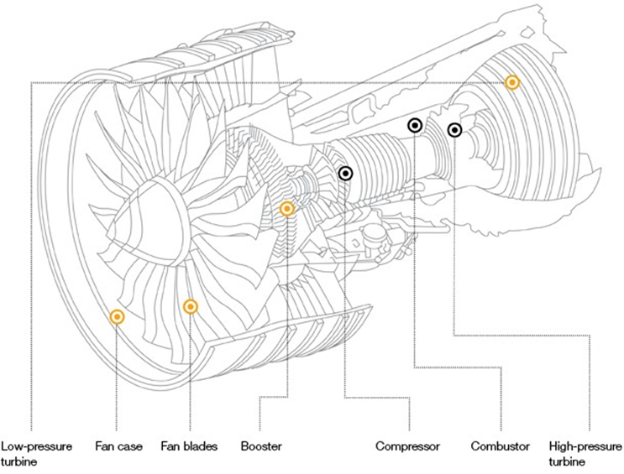
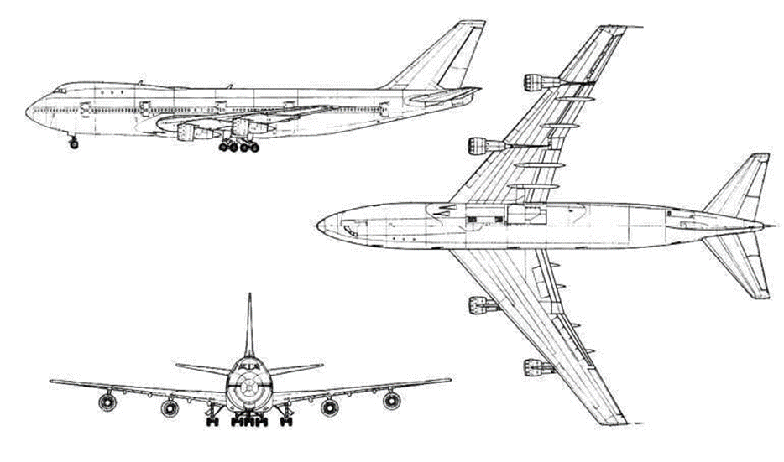
Background Information
General Airplane Parameters
Measurements
Weight - 334 tons
Fuel Capacity - 48500 gallons
Cruising Speed - 0.84 Mach
Engine Models
PW JT9D-7A
GE CF6-45A2
RR RB211-524 B2

Slide 5
Accident Characteristics
Accident
Explosion -> Overpressure -> Rotation -> Crack Probagation -> Seperation -> Breakup
Direct Cause
High Voltage being released into the FQIS in the CWT
Root Cause
Short Circuiting in unidentifiable nearby systems
Overpressure event in the CWT caused the breakup, but why?
Contributing Cause
Fuel temperature being higher than usual
Casual Factor
Fuel-Air mixture being less in quantity than usual

Slide 6

How and Why did the Excess Voltage cause an Explosion on the FQIS Wiring System?
Arcing & Silver Sulfide Deposits
The critical relation between the Root Cause (Short Circuiting) and the Direct Cause (Ignition Energy)

Slide 7

Fuel Performance Analysis
Kerosene with the mixture of air Jet A
Flash Point
Higher flash point
Higher octane ratings
Le Chatelier's rule and the critical value of fuel-air mass ratio at the can determine flammability limit
Flash point between 29°C - 74°C.
A typical commercial aircraft 0.3J energy is enough to ignite fuel
Lower Viscosity
Cost
Average price of kerosene is 1.11 $/Lt.
Average price of gasoline is 1.41 $/Lt.

Slide 8
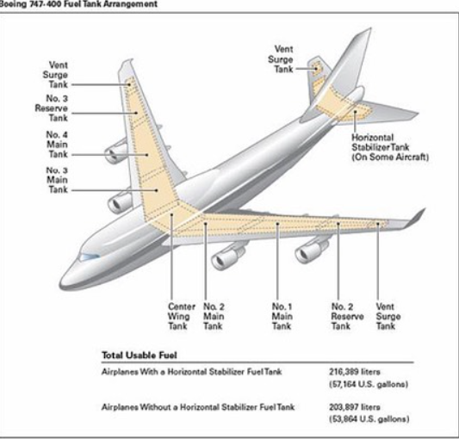
Fuel Tank and Fuel System Analysis
Fuel system is one of the most essential systems to power the engines and help restore the balance of the aircraft
The fuel tanks are usually positioned at the wings, however in larger aircrafts there are additional fuel thanks which are called the Central Wing Tank (CWT).
Balances the center of mass with the fuel system pumps

Slide 9
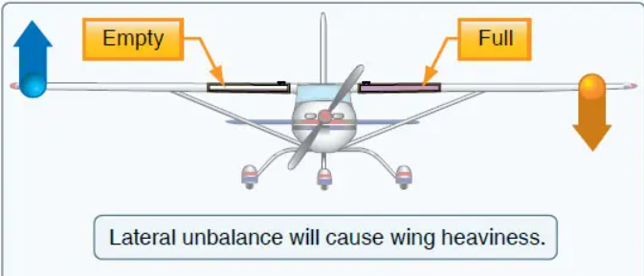
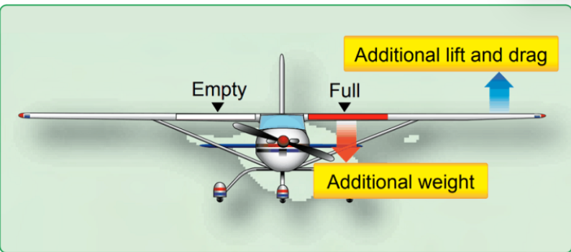
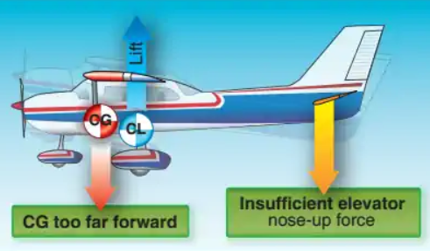
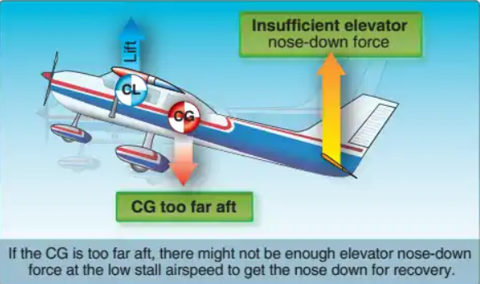
Role on the Balance
If the CG is too far aft, there might not be enough elevator nose-down force at the low stall airspeed to get nose down for recovery.

Slide 10
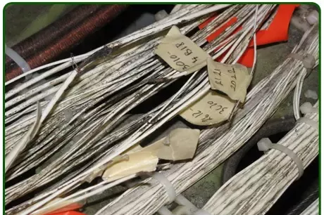
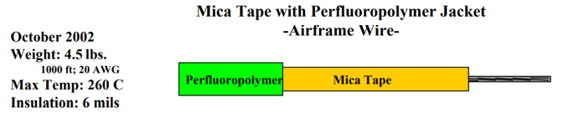
Aircraft Electrical Wires
The aircraft wires also take important space on the plane and add considerably to the overall weight of the plane
Boeing 747 uses approximately 2.25x10^5 meters of wire, weighing about 1500 kg
Ways to decrease weight
Less copper content
Reducing the weight of insulation.
Maintain circuit integrity, no spark should occur
The Aging one of the important factor in wires
The Boeing 747’s wires were 24 years old

Slide 11
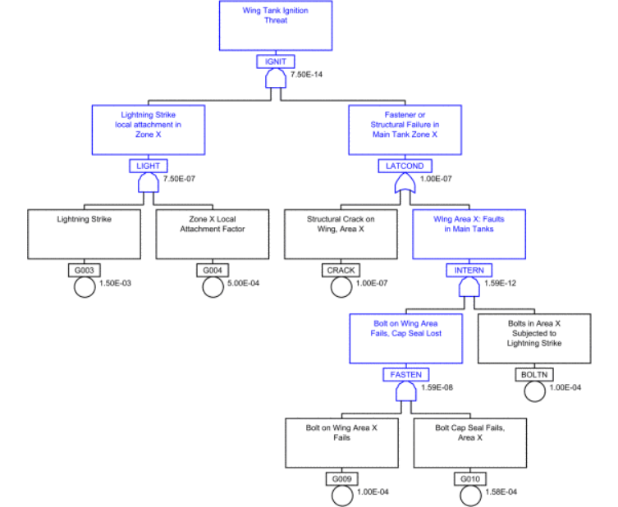
Statistical Reliability
Fault Tree Analysis (FTA) by the Federal Aviation Administration
New regulations are implemented in FAR 25.981. (M. E. Hill and L. E. Bechtold, 2014)
The concluded probability of failure is 1×10⁻⁷ which is trivial

Slide 12
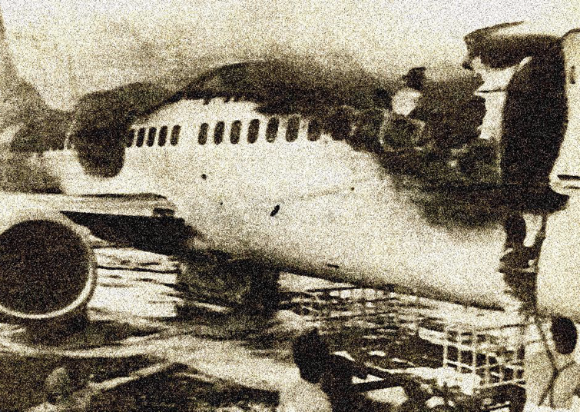
Related Accidents
Thai Airways International Flight 114, 3 March 2001
Philippine Airlines Flight 143, 11 May 1990
Both aircrafts were on the ground at the time of the incident
Central Wing Fuel Tank
Both airplanes had AC on for a while on the ground

Slide 13

Corrective Actions
Better Insulation in Nearby Electrical Systems
Nitrogen-Inerting Systems
Cooler Ground Fuel Tanks
Research on Silver-Sulfide Deposit Hazardousness
Inspection of Existing 747's
Less Sharp Terminal Block Geometries
Relocating the Terminal Block

Slide 14
References
1. F. Temman, “TWA flight 800 crash was caused by design flaw in fuel tank, report claims,” The Irish Times. https://www.irishtimes.com/news/twa-flight-800-crash-was-caused-by-design-flaw-in-fuel-tank-report-claims-1.1260823#:~:text=The%20inquiry%20said%20the%20generators (accessed May 23, 2022).
2. J. E. Shepherd, C. D. Nuyt, J. J. Lee, and J. E. Woodrow, “Flash Point and Chemical Composition of Aviation Kerosene (Jet A),” resolver.caltech.edu, May 26, 2000. https://authors.library.caltech.edu/25832/(accessed May 23, 2022).
3. “Why Airplanes Use Kerosene Rather Than Plain Gasoline for Fuel | Blog- Monroe Aerospace.” https://monroeaerospace.com/blog/why-airplanes-use-kerosene-rather-than-plain-gasoline-for-fuel/#:~:text=With%20its%20higher%20flash%20point (accessed May 23, 2022).
4. J. Knezevic, “Microbial Decontamination of Fuel Tanks as a Mechanism of the Motion of an Aircraft through MIRCE Space,” Archives in Biomedical Engineering & Biotechnology, vol. 4, no. 5, Nov. 2020, doi: 10.33552/abeb.2020.04.000598.
5. “Weight and Balance,” www.cfinotebook.net. https://www.cfinotebook.net/notebook/aerodynamics-and-performance/weight-and-balance
6. “Balance, Stability, and Center of Gravity – Effects of Adverse Balance,” Flight Literacy, Nov. 30, 2017. https://www.flightliteracy.com/balance-stability-and-center-of-gravity-effects-of-adverse-balance/
7. A. Tips, “Why Is Weight And Balance Important In Aviation?,” AviatorTips.com, Oct. 24, 2019. https://www.aviatortips.com/why-is-weight-and-balance-important-in-aviation/
8. T. E. R. Walter Cinibulk, “Aircraft electrical wire; wire manufacturers perspective,” 2001 (accessed May 23, 2022).
9. "Aircraft Accident Report: In-Flight Breakup over the Atlantic Ocean, Trans World Airlines Flight 800, Boeing 747-131, N93119, Near East Moriches, New York, July 17, 1996" National Transportation Safety Board (NTSB), 2000 http://www.ntsb.gov/doclib/reports/2000/AAR0003.pdf.
10. M. E. Hill and L. E. Bechtold, "Protecting aircraft fuel tanks using reliability analysis," 2014 Reliability and Maintainability Symposium, 2014, pp. 1-5, doi: 10.1109/RAMS.2014.6798500
11. “Airplane exploded at gate, Aircraft Accident Report, Thai Airways International Company Limited, Boeing Company 737-400, HS-TDC.” [Online]. Available: https://www.fss.aero/accident-reports/dvdfiles/TH/2001-03-03-TH.pdf
12. RB211-524G/H &amp; -T. Rolls. (n.d.). Retrieved June 4, 2022, from https://www.rolls-royce.com/products-and-services/civil-aerospace/airlines/rb211-524gh-and-t.aspx#section-technology
13. B741. SKYbrary Aviation Safety. (2021, September 2). Retrieved June 4, 2022, from https://skybrary.aero/aircraft/b741
14. Aero - 747-8 offers operational improvements and cross-model commonality. (n.d.). Retrieved June 4, 2022, from https://www.boeing.com/commercial/aeromagazine/articles/2010_q3/2/

